Slide 1
IT Infrastructure

Slide 2
Introduction
In this presentation, we'll dive into the world of IT Infrastructure, exploring where applications live and gaining insights into the essential hardware components that power modern technology.

Slide 3
What is IT Infrastructure?
IT Infrastructure refers to the underlying foundation of hardware, software, networks, and services that support the organization's technology needs
It serves as the backbone of information systems, enabling applications and data to be available, accessible, and secure

Slide 4
Where Do Applications Live?
Applications can reside in different environments based on the organization's needs:
On-Premises: Applications hosted and maintained on local servers within the organization's data centers.
Cloud: Applications hosted on cloud platforms, providing scalability, flexibility, and cost-efficiency.
Hybrid: A mix of on-premises and cloud environments, allowing organizations to leverage the best of both worlds.
Installed on the user's machine (desktop apps)

Slide 5
On-Premises Infrastructure
On-premises infrastructure involves:
Local Servers: Physical hardware hosting applications and data within the organization's data centers.
Data Centers: Facilities dedicated to housing servers, storage, networking equipment, and cooling systems.

Slide 6
Cloud Infrastructure
Cloud infrastructure offers numerous benefits:
Scalability: Easily adjust resources based on demand.
Accessibility: Applications and data accessible from anywhere with an internet connection.
Cost Savings: Reduced upfront capital expenditures, pay-as-you-go models.
Redundancy: Data replication across multiple locations for enhanced reliability.

Slide 7
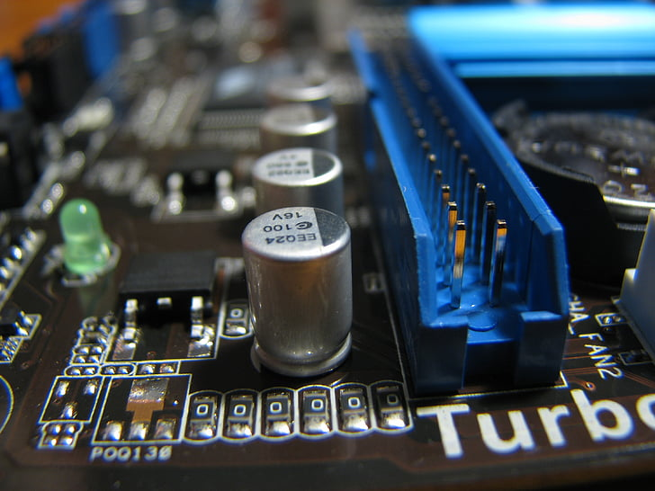
Hardware Overview
Hardware is the physical equipment that comprises IT infrastructure:
Servers: Powerful computers that store and process data, hosting applications and services.
Storage: Devices used to store vast amounts of data, such as hard drives and solid-state drives.
Networking Equipment: Routers, switches, and firewalls that facilitate data communication.
End-User Devices: Computers, laptops, tablets, smartphones used by employees to access applications and data.

Slide 8
The Role of Hardware in Performance
Hardware directly impacts performance:
CPU (Central Processing Unit): Performs calculations and executes tasks.
RAM (Random Access Memory): Temporarily stores data and instructions for faster processing.
Storage Speed (HDD vs SSD): Determines how quickly data can be accessed and retrieved
Network Bandwidth: Affects the speed of data transmission between devices.

Slide 9
Thank you!
Q & A

